Slide 1

Neural Unsupervised Paraphrasing
Team: Confidant-tri-gram
Zeeshan Khan (2021701029)
K. N. Amruth Sagar(2021701013)
Seshadri Mazumder(2021801002)
Course Name : Intro to NLP
Course ID : CS7.401
Instructors : Prof. Manish Srivastava
Assigned TA : Ananya Mukherjee
Project Link : NLP_Project

Slide 2
Index
Sl No | Topic | Sl No | Topic
1. | Introduction | 6. | Quantitative Evaluation
2. | Problem Statement | 7. | Qualitative Evaluation
3. | Methodology | 8. | Self Collected Data
4. | Datasets | 9. | Conclusion & Future Work
5. | Evaluation Metrics | 10. | References

Slide 3
Introduction
Paraphrasing is rewriting a given sentence in other words or forms without losing the meaning of the original sentence.
Paraphrasing can be achieved via training a deep sequence to sequence models, like RNN, LSTMs, Transformers etc, in a supervised setting.
Creating supervised datasets for paraphrasing is both time and cost expensive.
Therefore, several approaches aims to achieve paraphrasing using unsupervised methods.
In this project we aim at generating paraphrases using the idea of corrupting a sentence and reconstructing the correct sentence using deep auto-regressive denoising approaches.

Slide 4
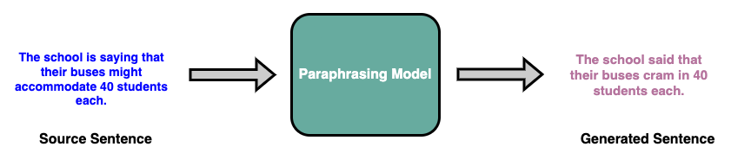
Problem Statement
Given a sentence in natural language, we aim at generating a new sentence with the same meaning but different language structure in an unsupervised setting.

Slide 5
Datasets
We train and evaluate our model on 3 datasets:
Dataset | Train sentences | Valid sentences | Test Sentences | vocab
QQP : Quora Question Pair dataset | 404290 | - | - | 73948
PAWS : Paraphrase Adversaries from Word Scrambling dataset | 49401 | 8000 | 8000 | 35583
Microsoft Research Paraphrase Corpus | 5803 | - | - | 21608

Slide 6
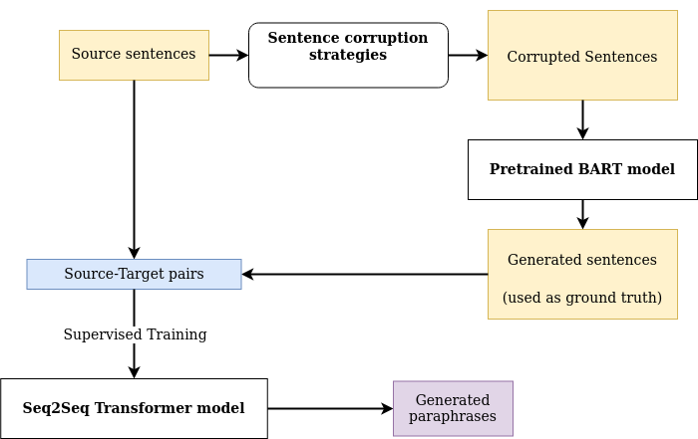
Pipeline

Slide 7
Data Corruption Techniques
Token Masking:
Ex: Source sentence: Amrozi accused his brother, whom he called "the witness", of deliberately distorting his evidence.
Corrupted sentence: Amrozi accused his brother, <mask> he <mask> "the witness", of <mask> distorting his evidence
Token Masking:
Ex: Source sentence: Amrozi accused his brother, whom he called "the witness", of deliberately distorting his evidence.
Corrupted sentence: Amrozi accused his brother, he called "the witness", of deliberately his evidence.

Slide 8
Data Corruption Techniques
Text Infilling:
Ex: Source sentence: Amrozi accused his brother, whom he called "the witness", of deliberately distorting his evidence.
Corrupted sentence: Amrozi accused his brother, <mask> "the witness", of deliberately distorting his evidence
Document rotation:
Ex: Source sentence: Amrozi accused his brother, whom he called "the witness", of deliberately distorting his evidence.
Corrupted sentence: Of deliberately his evidence. Amrozi accused his brother, he called "the witness".

Slide 9
Taking inference from BART Model
Bart is an auto-regressive generative language model.
It is pre-trained on the task of masking and autoregressive denoising.
It has a transformer encoder which encodes a corrupted/masked sentence
It has a transformer decoder which predicts the masked tokens in an autoregressive manner.
Since we are working in an unsupervised setting, we create pseudo-ground truths for the task of paraphrase generation.
We corrupt the sentences using the 4 strategies described previously.
The noisy/masked sentence is fed to BART, it denoises the sentence and reconstructs it in an autoregressive manner.

Slide 10
What we have now ?
Now we have a source sentence.
4 Corresponding masked/corrupted sentence.
4 Denoised sentences.
We use the source sentence as the source.
We use the 4 denoised sentences as pseudo-ground truths.

Slide 11
Transformers : Data Preparation
We clean the sentences, numericalise the tokens and convert a sentence to a tensor.
We Add <SOS> <EOS> tokens to represent start and end of statements.
To take advantage of large scale training in batches which improves the transformers performance, we add the functionality of batching in our training.
To enable batching we converted all the sentences to have a same length.
For that we define a max length of tokens for any given batch of sentences, and add padding to fill in the max length. We use <PAD> token for padding.
To handle the padding during training, we create transformer padding mask of size max length for the whole batch, with 1 where real token exists and 0 for <PAD> token.
Since we use teacher forcing for autoregressive decoding, we create a transformer attention mask for the decoder, with upper triangular matrix filled with 1 and rest 0. This makes sure that the model does not look into the future tokens and cheat.

Slide 12
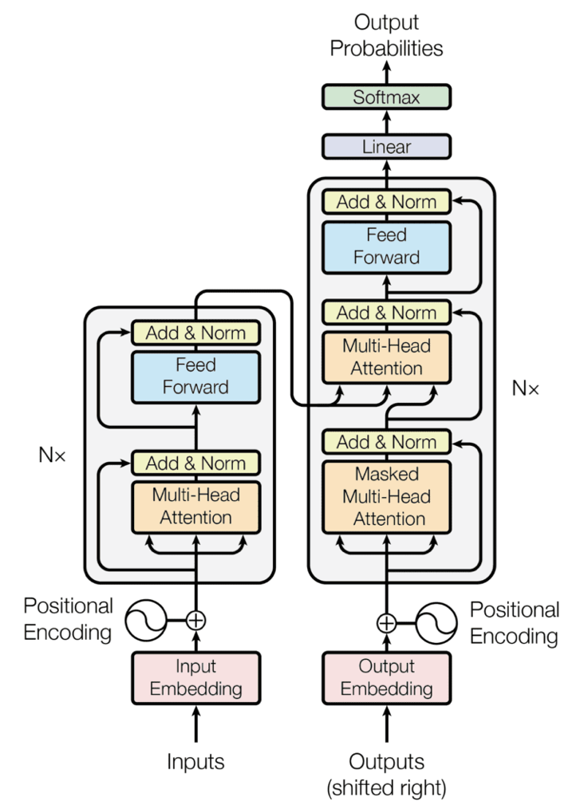
Standard Transformer Architecture
Transformer is an encoder decoder style deep neural network model.
It is able to parallely process the entire sequence while attending to the useful information using key, query and, value style attention and encode the whole sequence. It uses self attention in the encoder.
In the decoder it uses cross attention to extract useful information from the encoded sequence to help with the decoding.

Slide 13
Results
&
Discussions

Slide 14
Quantitative Evaluation of PAWS Data
BLEU Score : 7.312 on test set of MSR Paraphrase dataset.
This score is from checkpoint : 72

Slide 15
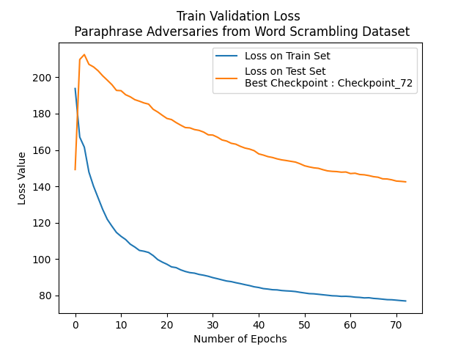
Train & Valid loss graph : PAWS Dataset

Slide 16
Qualitative Evaluation of PAWS Data
Pair 1
Target : JOHN BARROW ISLAND IS A MEMBER OF THE QUEEN ELIZABETH ISLANDS IN THE CANADIAN ARCTIC ARCH
Predicted : JOHN A MEMBER OF PARLIAMENT OF THE CANADIAN PROVINCE OF CANADA IN THE CANADIAN PROVINCE
Pair 2
Target : BEST MOVIE AT THE 7TH YOKOHAMA FILM FESTIVAL IT WAS CHOSEN AS THE
Predicted : IT WAS THE FIRST TIME AS THE SECOND TIME AS THE 7TH BEST FILM FESTIVAL
Pair 3
Target : ALL FIVE EVENTS STARTED THE LAST DAY OF THE TOURNAMENT AND CONCLUDED WITH THE FINAL ON THE
Predicted : THE FIRST FIVE ON THE AREA WERE THE FIRST AND LAST WITH THE FINAL

Slide 17
Quantitative Evaluation of MSR Data
BLEU Score : 53.439 on test set of MSR Paraphrase dataset.
This score is from checkpoint : 278

Slide 18
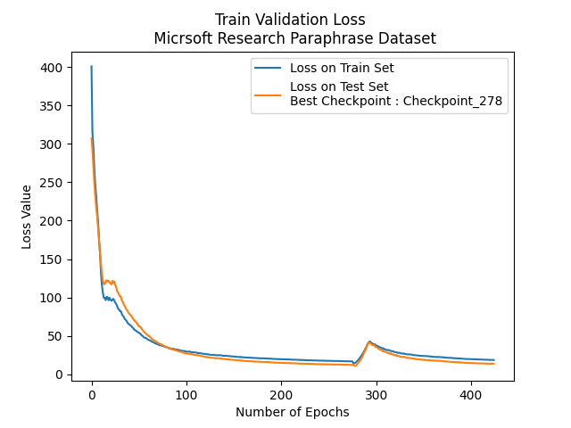
Train & Valid loss graph : PAWS Dataset

Slide 19
Qualitative Evaluation of MSR Data
Pair 1 :
Target : THE WORLD S LARGEST AUTOMAKERS SAID THEIR U S SALES DECLINED MORE THAN EXPECTED LAST
Predicted : THAN EXPECTED THE WORLD S TWO LARGEST AUTOMAKERS SAID THEIR U S SALES DECLINED
Pair 2:
Target : LOSSES AND FAVORABLE INTEREST RATES THE INCREASE REFLECTS LOWER CREDIT
Predicted : THE INCREASE REFLECTS LOWER CREDIT LOSSES AND FAVORABLE MARKET CONDITIONS
Pair 3 :
Target : FEDERAL AGENTS SAID YESTERDAY THEY ARE INVESTIGATING THEFT OF 1 200 OF AN EXPLOSIVE CHEMICAL FROM
Predicted : FEDERAL AGENTS SAID YESTERDAY THEY ARE INVESTIGATING THE THEFT OF A TOTAL OF 1 200 POUNDS

Slide 20
Conclusion
Neural unsupervised is yet a challenging task and there's a lot of further research scope in this field.
We first corrupt the sentences and then used BART's model to curate pseudo ground truth sentences.
Then we trained an supervised end to end transformers from scratch and wqe achieve reasonable accuracies in the MSR dataset.
We couldn't train our model on QQP dataset due to time \& resource constraint.
We also achieve some scores on the PAWS dataset, however the training loss graph shows, that further training can improve the results more, and there's a lot of scope for loss convergence.
Experimenting with multiple datasets and jointly training them for various domains and using gradient blending between them still remains as a future scope to us.

Slide 21
Thank You

